Slide 1
Brand Audit
Trevor Carss
Notes:
https://www.google.com/imghp - add client logo from image search. Ensure it matches with their website.

Slide 2
Details
This analysis provides insights on:
Consumers Who is buying your products and services?
Content What is working on social and what needs optimization?
Community Who is engaging with you and what are they feeling?
Competition Who is competing online in your space?
Conversions What brings you business success?

Slide 3
Consumers

Slide 4
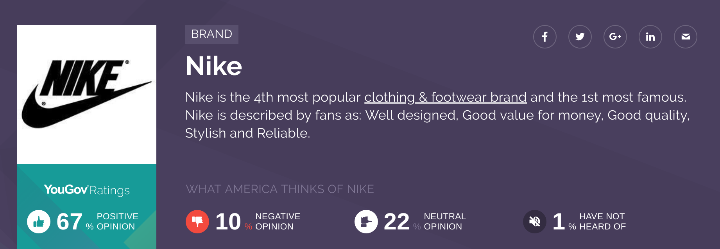
Brand Perceptions
How do consumers feel about your overall brand? Let’s have a look:
Notes:
https://today.yougov.com/

Slide 5
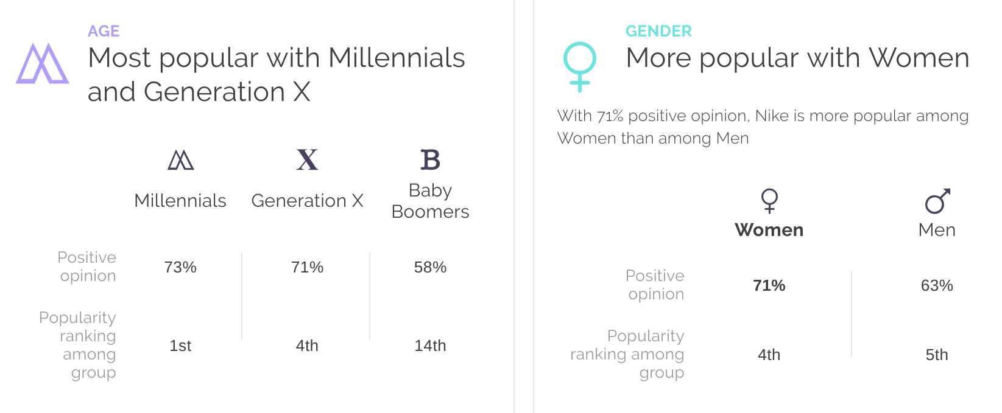
Demographics
Which demographic segments should you be targeting? Do you see any surprises?
Notes:
https://today.yougov.com/

Slide 6
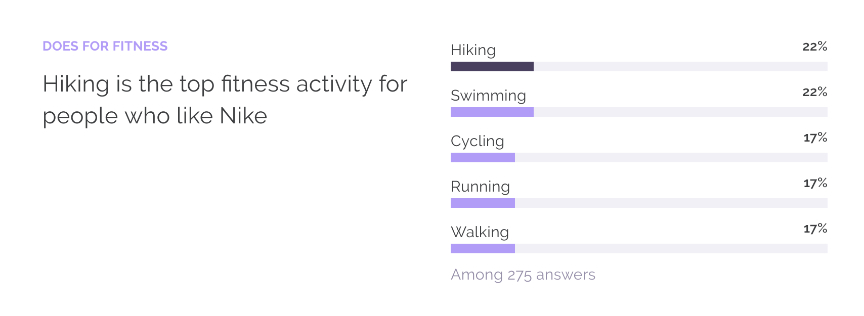
Consumer Interests
Are your products and services aligned with the interests of your consumers?
Notes:
https://today.yougov.com/

Slide 7
Popularity
Consumer interest around the brand in the past 12 months. What content can be created to spark conversations?
Notes:
https://trends.google.com/trends/

Slide 8
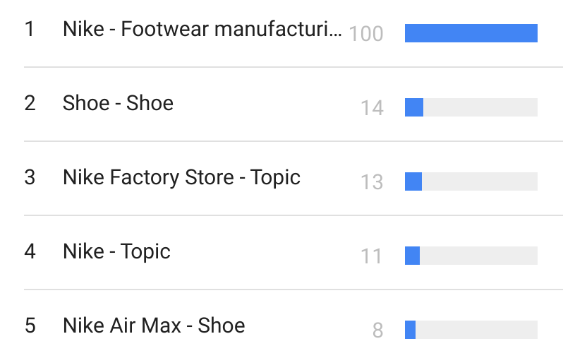
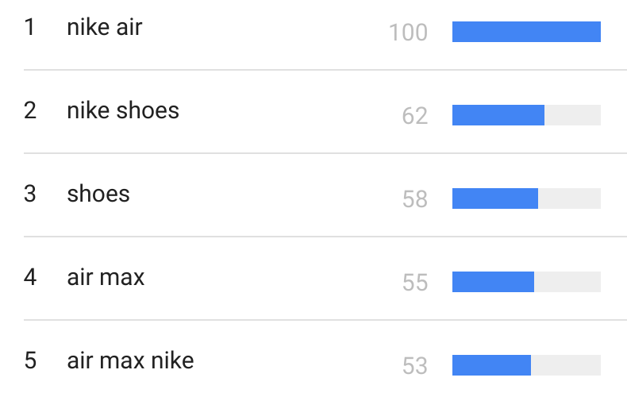
Consumer Search
These are the most-searched topics and queries related to the brand:
Notes:
https://trends.google.com/trends/

Slide 9
Product Alignment
How cohesively your product offering aligns with consumers.
Notes:
Analyze product. What do customers say about it? Is it solving a problem for them?

Slide 10
Content

Slide 11
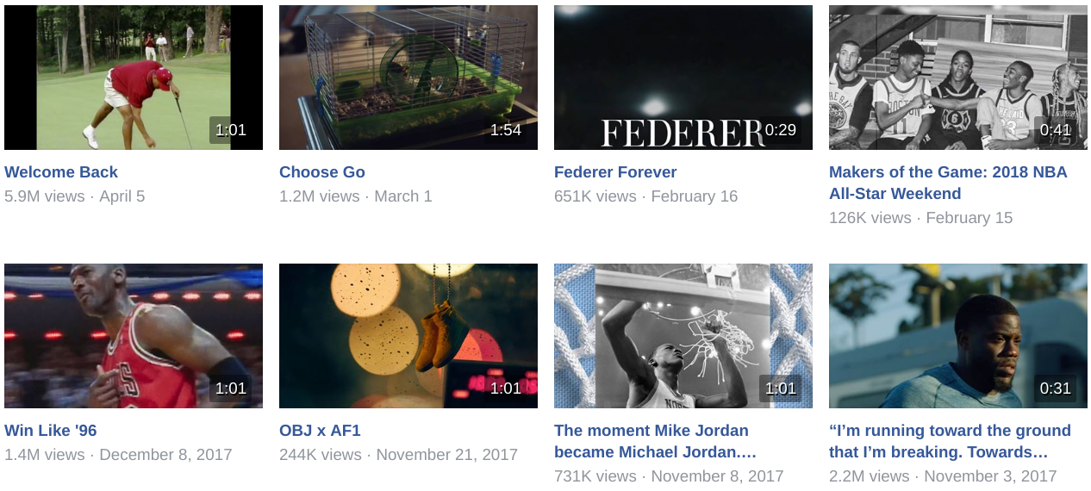
Video
If video investment is a priority, it might be useful to think like a broadcaster in terms of series content and scheduling to generate recurring views.
Notes:
https://www.facebook.com/ + https://www.youtube.com/ - then search for client name

Slide 12
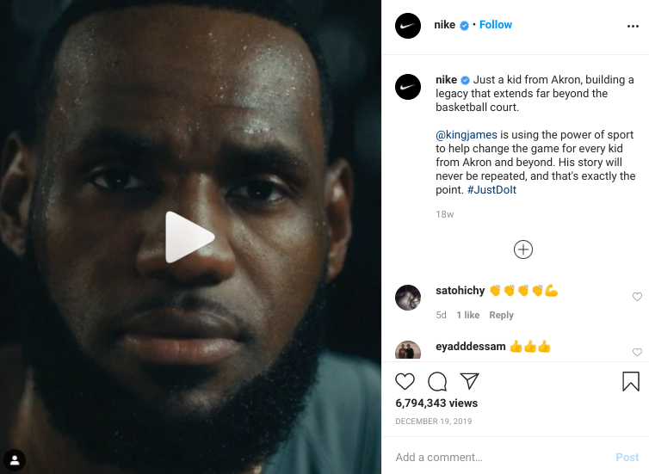
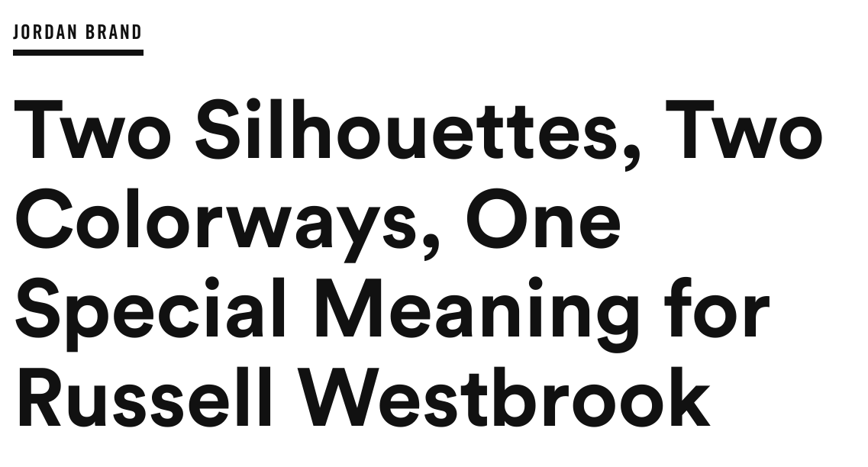
Written + Images
What are your themes across written and image content?
Notes:
Blog + Instagram

Slide 13
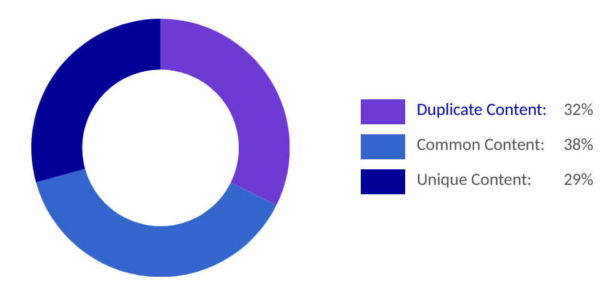
Content Quality
A mix of long-form, unique posts and re-shares are critical to your content marketing strategy. Here is what we discovered with your recent efforts:
Notes:
http://www.siteliner.com/

Slide 14
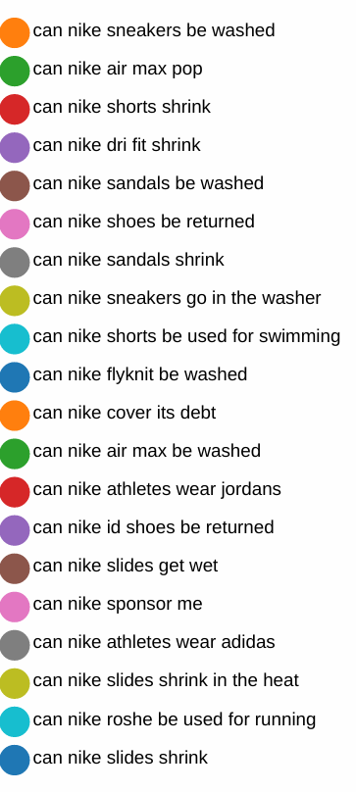
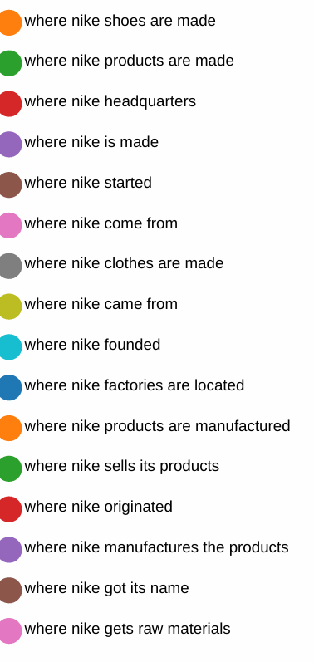
Content Questions
Your consumer is asking these questions and more. Future content ideas?
Notes:
https://answerthepublic.com/

Slide 15
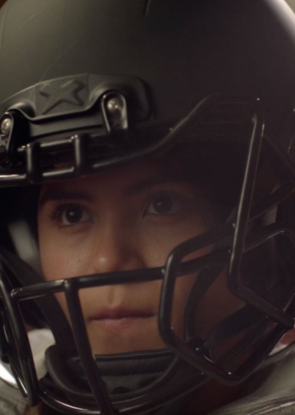
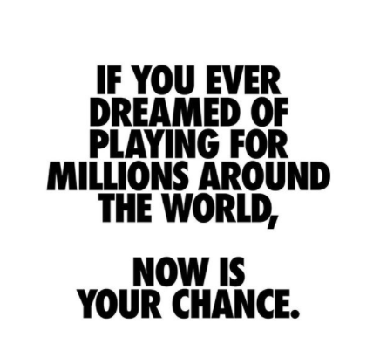
Advantage
What makes your content stand out from the crowd?
Notes:
Look at social feeds, copywriting, analyze what has gone viral, what the brand message is

Slide 16
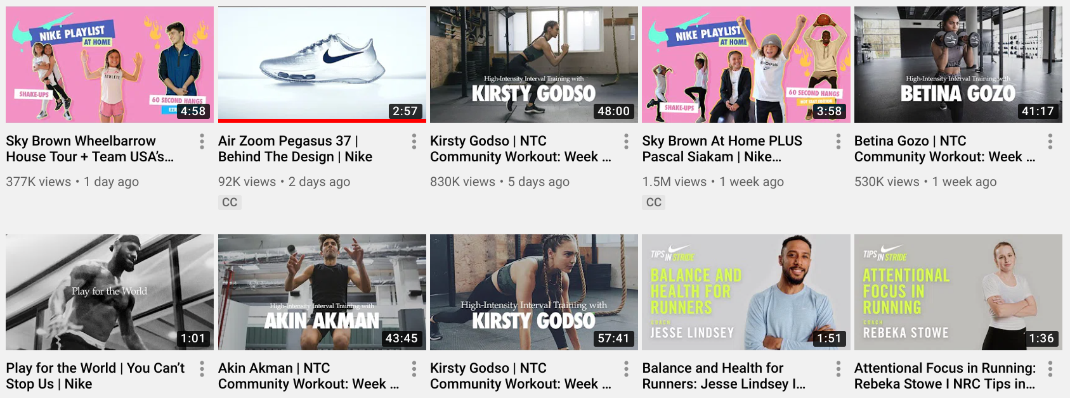
Boost
Where you can gain more visibility for your content.
Podcast and series content with top athletes would be more popular.
Notes:
Identify options to increase brand awareness - platforms, new content ideas

Slide 17
Community

Slide 18
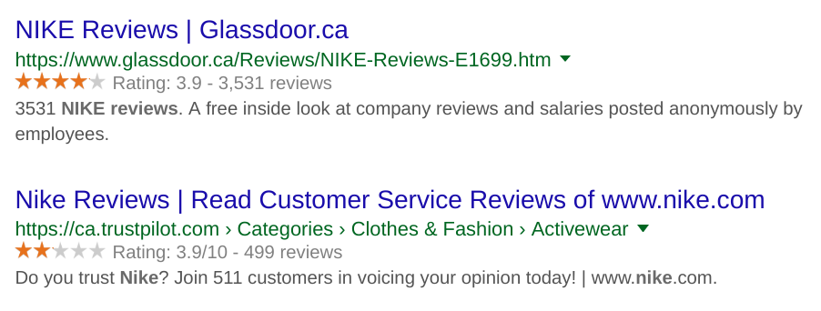
Reviews
How do you feel about this community response to your brand?
Notes:
https://www.google.com - Type in “BRAND + Reviews”

Slide 19
Engagement on Facebook
Above 1% engagement rate is good; 0.5%-0.99% is average; and below 0.5% suggests realigning your messages to your audience’s expectations for improved community engagement.
Notes:
https://likealyzer.com/

Slide 20
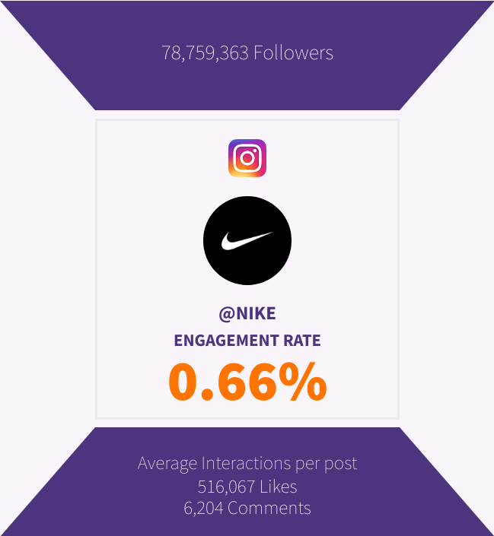
IG Engagement Rate
An engagement rate between 0% and 1.64% is considered to be low.
An influencer with a low rate on Instagram could expect between 0 - 16.4 reactions for every 1000 followers.
Engagement rates between 1.64% and 3.48% are considered to be good.
Notes:
https://phlanx.com/engagement-calculator

Slide 21
Top Influencers
What are you doing to maintain relationships with your top influencers?
Notes:
https://hashtagify.me

Slide 22
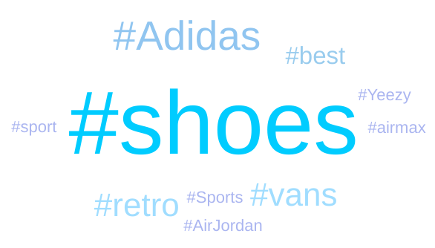
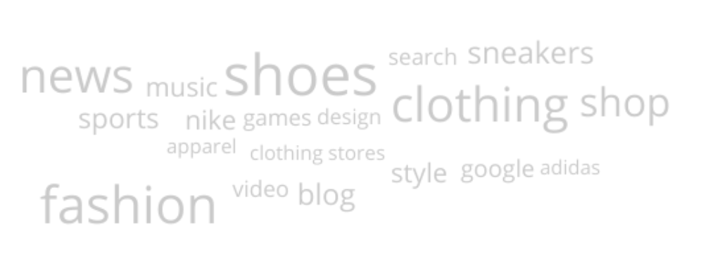
Word Clouds
What campaigns can focus on these top keywords related to your brand?
Notes:
https://hashtagify.me and https://www.similarweb.com/

Slide 23
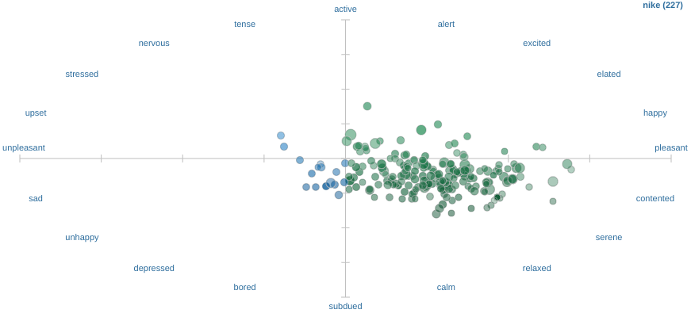
Sentiment
Feelings from your Twitter community:
Notes:
https://www.csc2.ncsu.edu/faculty/healey/tweet_viz/tweet_app/

Slide 24
Social Shares
What are your expectations for share count?
Notes:
https://sharescount.com/

Slide 25
Competition

Slide 26
Industry Ranking
Here is how you rank online for your industry. Any surprises?
Notes:
https://www.similarweb.com/ - then hit link underneath Category Rank.

Slide 27
Competitor Search
Here are your competitors based on organic and paid search. Any surprises?
Notes:
https://www.spyfu.com/

Slide 28
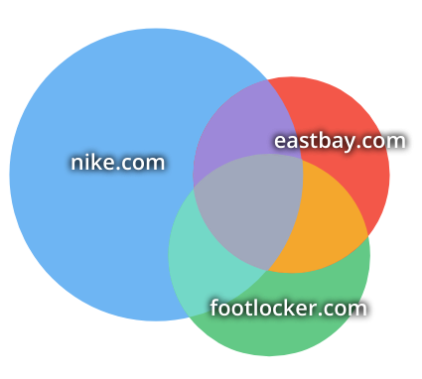
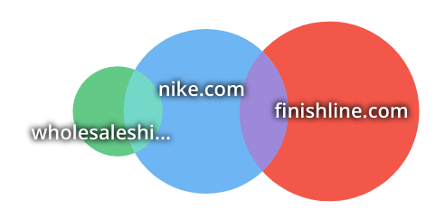
Keyword Competition
This is the overlap for shared organic (left) and paid (right) keywords.
Notes:
https://www.spyfu.com/

Slide 29
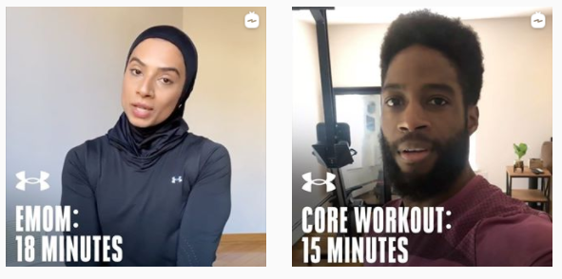
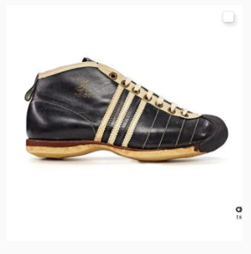
Competitor Social
Interesting things your competition is doing on social media.
Notes:
Review social feeds of top 2 competitors. Consider Instagram and YouTube.

Slide 30
Conversions

Slide 31
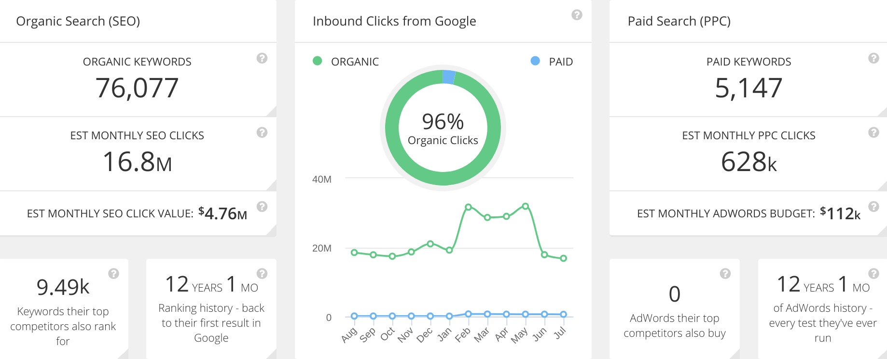
SEO Overview
Here are several key stats for your site. What stands out to you?
Notes:
https://www.spyfu.com/

Slide 32
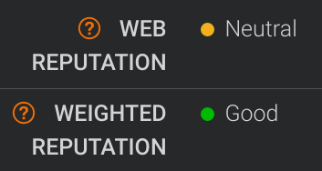
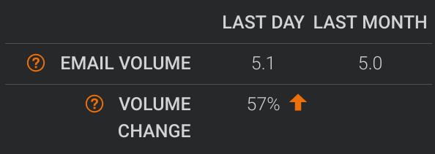
Email Reputation
The quality of your domain reputation affects email spam and deliverability.
Notes:
https://talosintelligence.com/

Slide 33
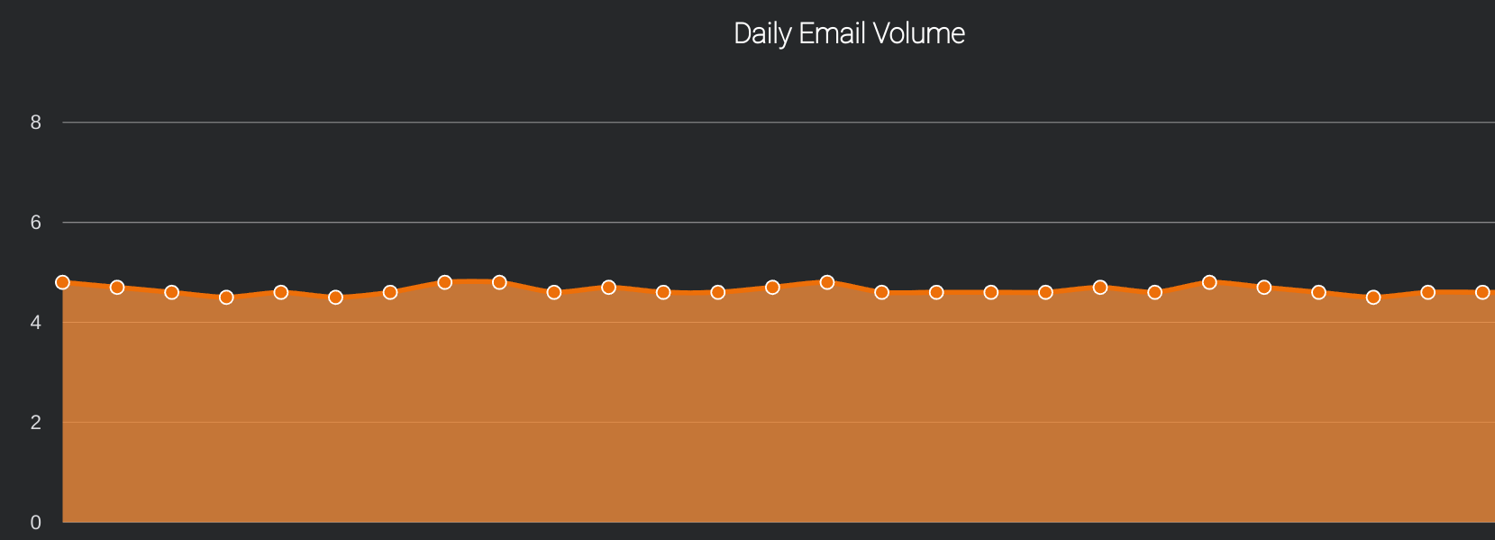
Email Volume
Email volume is scored as a percentage of the world’s total email sends. 5.0 = 0.001% of world volume.
Notes:
https://talosintelligence.com/ - EMAIL VOLUME HISTORY tab

Slide 34
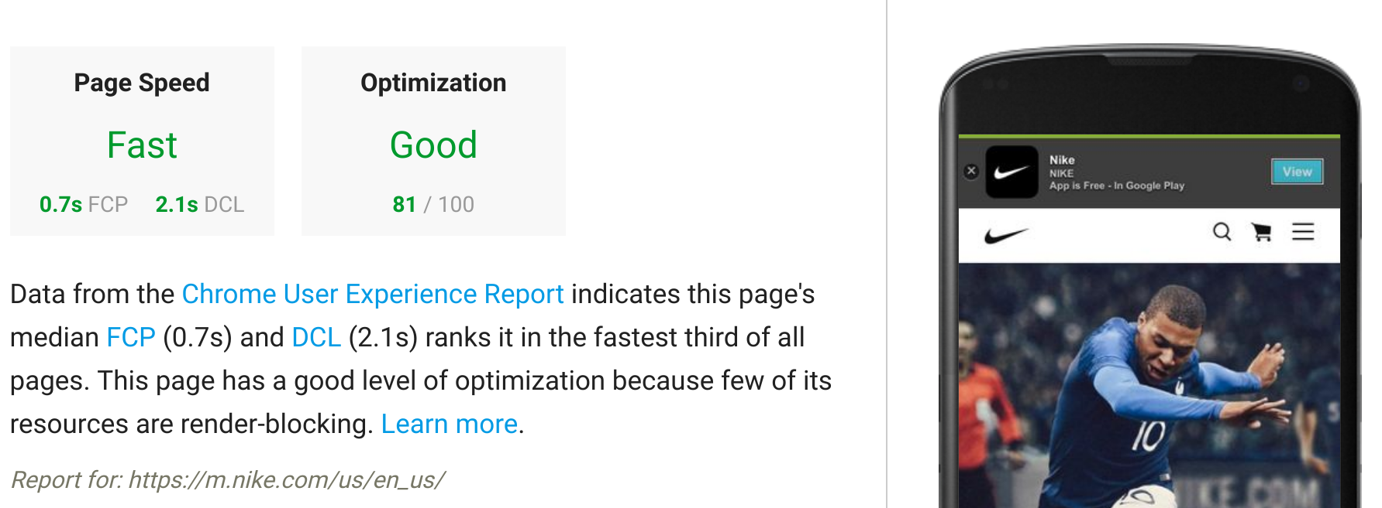
Page Speed
Speed equals revenue. Most websites lose half their visitors during page load. What do you think of your website speed?
Notes:
https://developers.google.com/speed/pagespeed/insights/

Slide 35
Speed Checklist
Leverage browser caching
Minimize redirects
Optimize images
Reduce server time
Minify your codes
Put CSS at the top and JS at the bottom
Reduce DNS lookups
Serve resources from a consistent URL
Avoid bad requests
Specify a character set
Remove query strings from static resources

Slide 36
Site Stats
Analysis of SEO and social media connectedness to your website.
Notes:
http://nibbler.silktide.com/

Slide 37
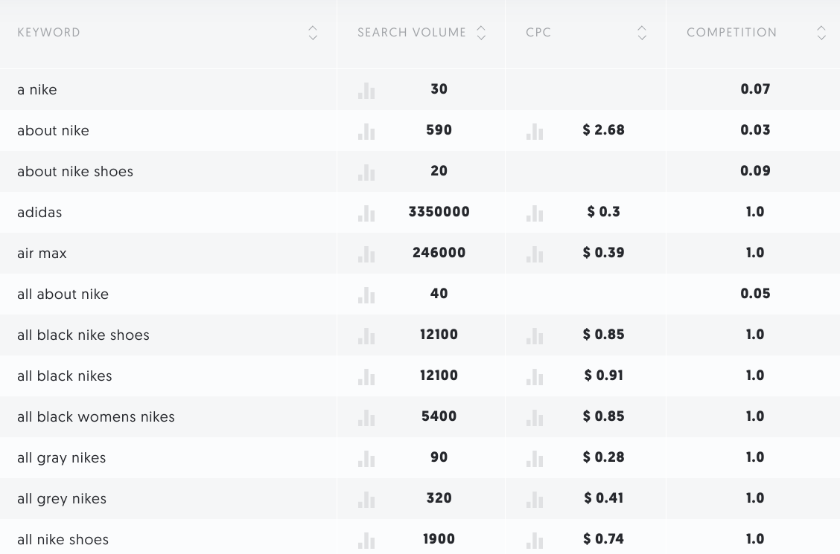
Keyword Research
Here are suggestions for keywords related to the brand:
Notes:
https://neilpatel.com/ubersuggest/

Slide 38
Positioning
Are these top market suggestions aligned with your internal brand positioning? What would you add or remove with this list?
Notes:
https://marketfinder.thinkwithgoogle.com

Slide 39
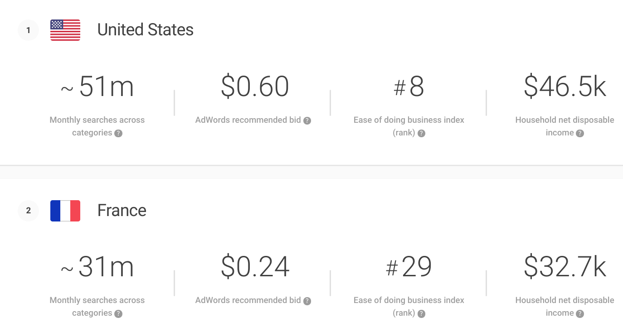
Opportunity Size
Based on the previous product categories, here are your opportunities:
Notes:
https://marketfinder.thinkwithgoogle.com

Slide 40
Backlink Overview
The success of your website on search engines is influenced by backlinking. How do you feel about these numbers?
Notes:
http://www.openlinkprofiler.org/

Slide 41
Traffic Sources
Here are your top traffic sources:
Notes:
https://www.similarweb.com/

Slide 42
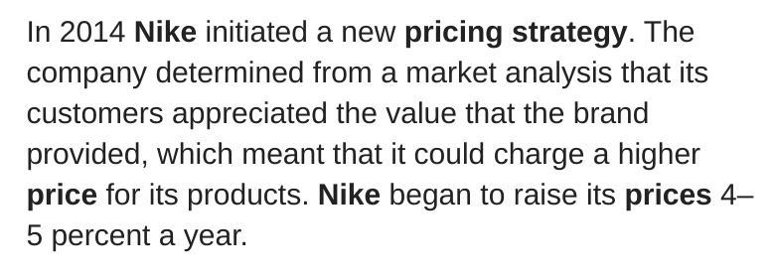
Pricing
A look at how pricing options may affect conversions.
Notes:
Go to client website for pricing data, compare to competitors

Slide 43
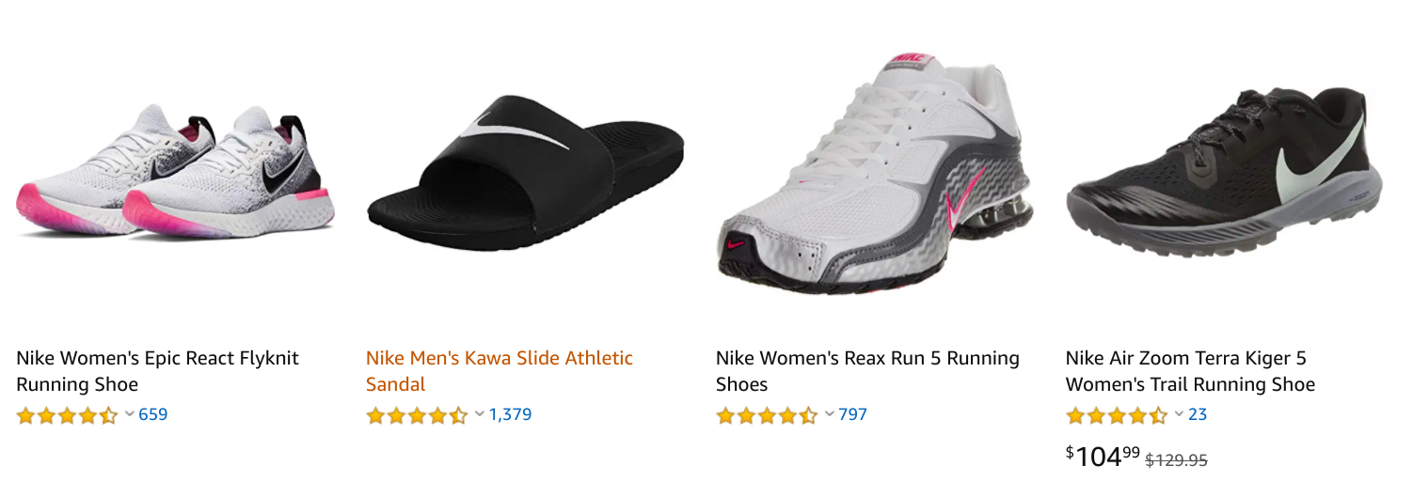
Distribution
Where more purchasing can happen.
Notes:
Analyze where product is distributed, mention options for more places

Slide 44
Analytics (Last Month)
Notes:
https://www.similarweb.com/

Slide 45
Partners
Notes:
https://www.similarweb.com/

Slide 46
Discussion
What questions do you have around this data?
How do you feel about your brand overall?
What is the biggest surprise to you?
What campaign ideas came to mind from the data?
What is one action item you would like to make by next week?

Slide 47
CLIENT • Trevor Carss
Notes:
Edit client name + logo

